Slide 2
SSE vs SignalR: Choosing the right real-time tool in .NET 10
And subsequent versions (soon)

Slide 3

Before we start…
Notes:
What if I told you that for some application, SignalR is solving a problem that we don’t actually have?

Slide 4
Real-Time? What does it mean?
Normal HTTP
SSE
SignalR
Request
Client
Request
Client
Server
Client
Server
Server
Client
Event
Server
Messages
Calls
Events
RPC
Response
Client
Server
Event
Client
Event
Server
Connection stays open
Connection stays open
BTW: SignalR supports SSE!
Notes:
Examples: Dashoabrd, Chat, Collaboration, Notifications, and recently: AI tokens streaming

Slide 5
What is SSE? And why now?
First proposed in 2004
Standard HTTP connection that uses text/event-stream content-type
One-way communication flow: server to client
Browser itself handles connection drops, without additional code
Easier to use after .NET 10 – Let’s see why!
Demo

Slide 6
So, why now?
Support for returning a ServerSentEvents result.
Supported by minimal APIs and Controllers
Less responsibilities as a dev
Responsibility | .NET 9 | .NET 10
Content-Type: text/event-stream | Manual | Automatic
Event formatting (data:, id:, event:) | Manual | Automatic
JSON serialization | Manual | Automatic
Response flushing | Manual | Automatic
Connection lifetime | Mostly manual | Integrated with cancellation
Returning typed objects | No | Yes
Named events | Manual text formatting | SseItem<T>
Event IDs | Manual text formatting | eventide property
Retry interval | Manual text formatting | reconnectionInterval property

Slide 7
SignalR
ASP.NET Core Open-source library
Automatic transport negotiation (WebSockets, SSE, Long Polling)
Two-way communication flow: server to client, and client to server
Use hub infrastructure as a high-level pipeline
Comes with ASP.NET Core, but needs a client library
Handles reconnections, grouping clients, and broadcasting messages
Demo

Slide 8
Comparison
Feature | SignalR | SSE
Communication | Two-Ways | Server -> Client (One way)
Transport | WebSockets, SSE, Long Polling | HTTP Streaming
Binary Messages | Yes | No
Fallback Mechanisms | Yes | No
Browser API | SignalR Client | Native EventSource
Groups/Users | Built-in | Implemented Manually
Demo

Slide 9
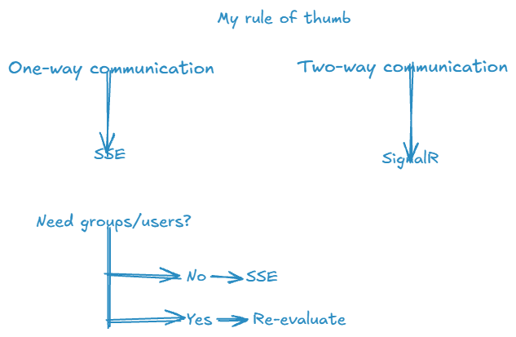
How to choose?
One way / two-way communication?
Trade-offs (users/groups)

Slide 10
Application Examples
SSE | SignalR
AI Token Streaming | Chat
Dashboards | Collaborative
Notifications | Multiplayer
Logs | Interactive

Slide 11
Final Takeaway
SSE is a stream
SignalR is a communication system
They are not really competing
Don't choose the most powerful tool. Choose the simplest tool that solves the problem.
Notes:
- If all I need is for my server to continuously tell the browser something happened, I don't necessarily need SignalR.
-

Slide 12

Questions?
Feedback.. Please?

